Slide 1

Implementing customizations for Microsoft Teams with Azure PaaS services
Laura Kokkarinen
Senior Developer & Architect
Sulava
@LauraKokkarinen

Slide 3
Answers to the following questions
Why and when to extend Teams?
What are the different app types and extension points?
How does Azure PaaS relate to all of this?

Slide 4
Why and when to extend teams?
Automation in general makes people more productive
No time spent on tedious tasks!
Why Teams?
Teams is the most natural place for displaying the information or performing the process or task

Slide 5
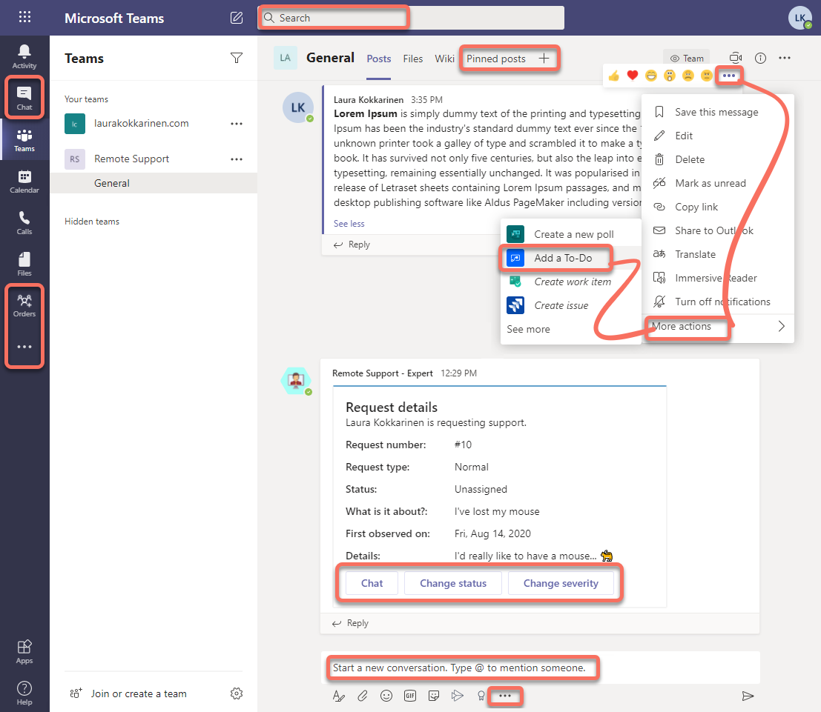
App types
Tabs
Bots
Messaging extensions
Webhooks
Incoming
Outgoing
Connectors

Slide 6
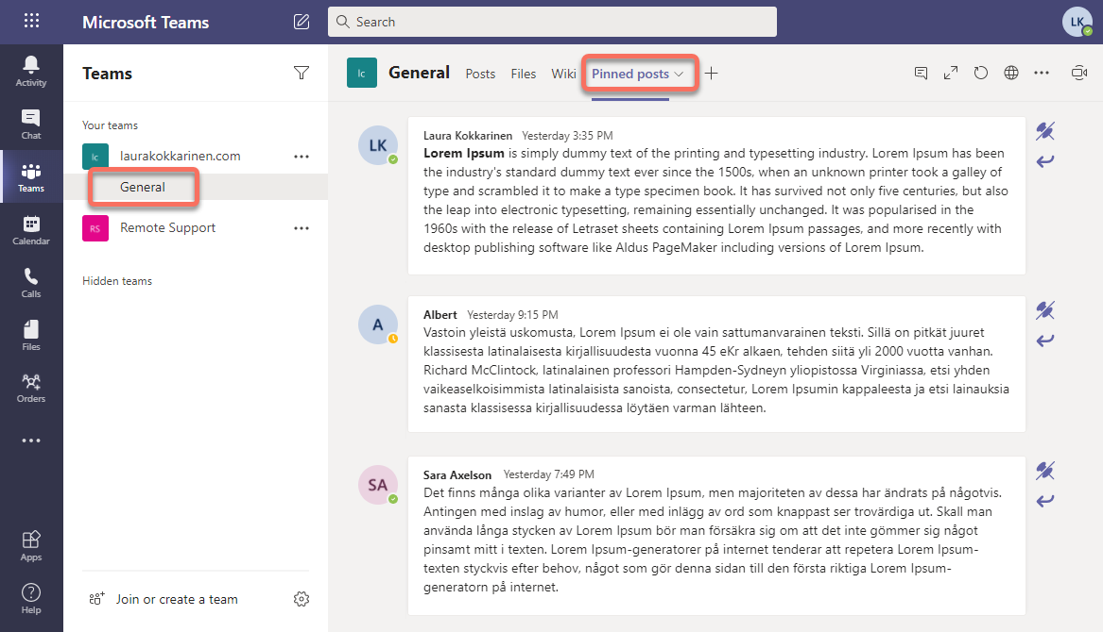
Tabs
When you want to display information (in the context of a team)
Most flexibility regarding UI
Web pages
Host them in Azure
Web app, App service plan

Slide 7

Teams app basic structure
azurewebsites.net
manifest.json

Slide 8
Tabs
When you want to display information (in the context of a team)
Most flexibility regarding UI
Web pages
Host them in Azure
Web app, App service plan
Other options
SPFx web part
Power Apps

Slide 9
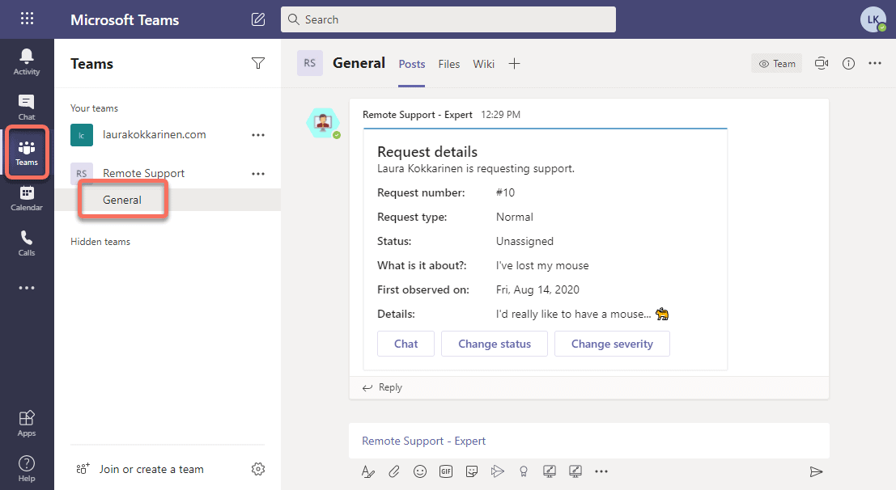
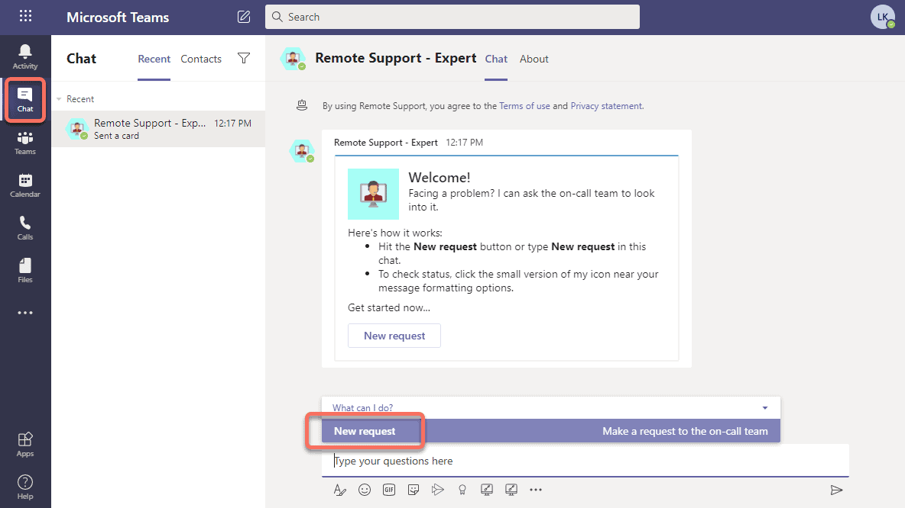
Bots
When a conversation is the most natural way of performing a task
Use via all the different types of chats
Web services
Host them in Azure
Web app, Bot service, App service plan
Scale down the app service plan to avoid costs while developing
Classic bot scenarios also use
QnA Maker
Language understanding (LUIS)
Other options
Power Virtual Agents (expensive!)

Slide 10
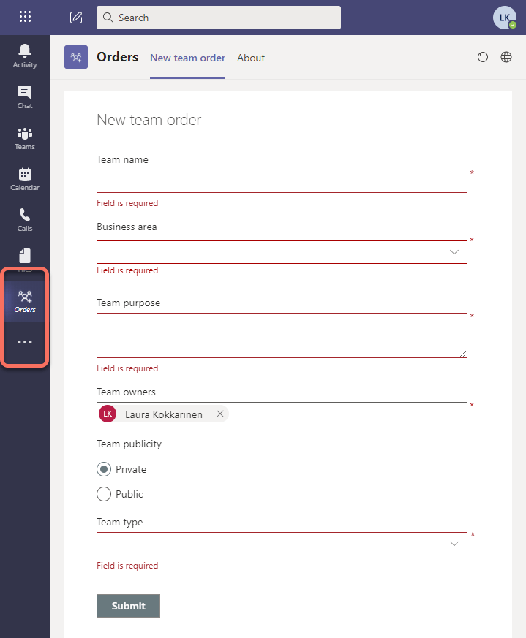
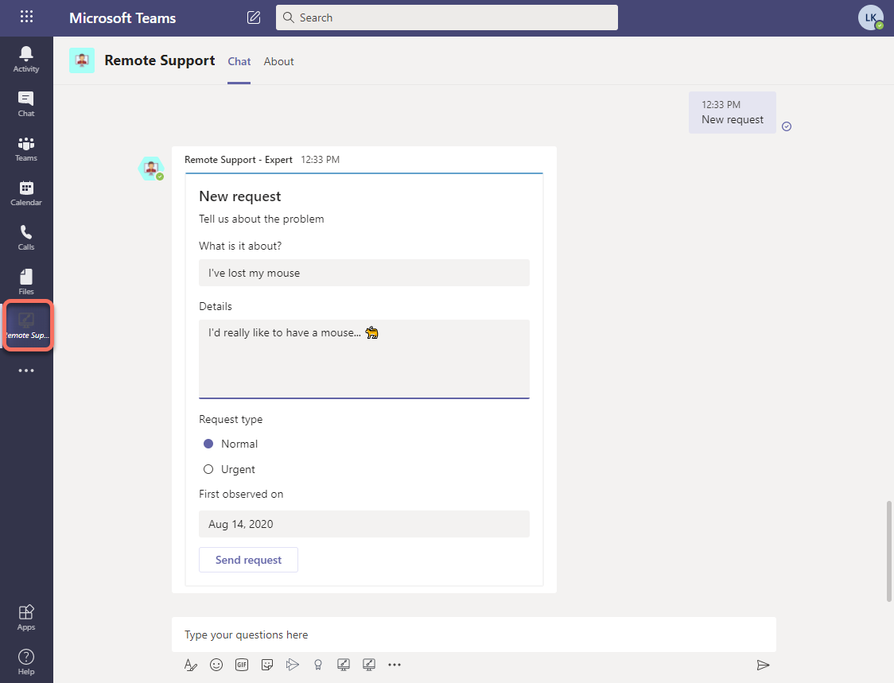
Personal apps
Pin bots and (static) tabs to the left-hand navigation
Configure the personal scope in the manifest file
Setup team app policies
When to use
Not related to any team
Offer easy access to the app for the user

Slide 11
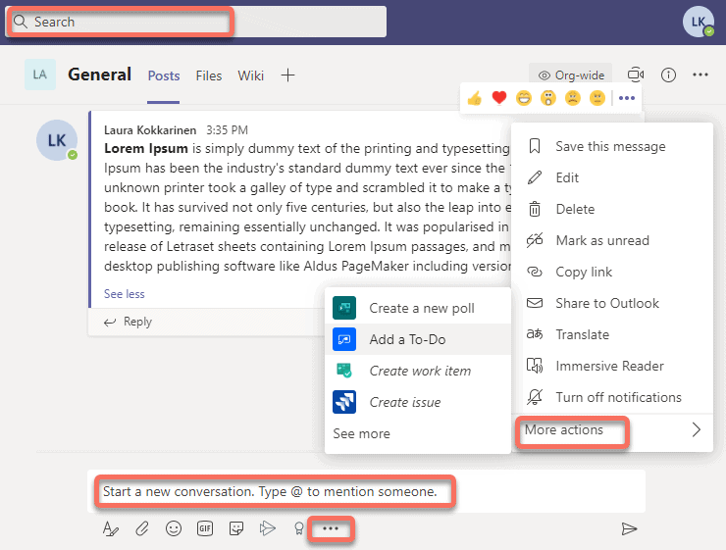
Messaging extensions
Technically very similar to bots
Web app, Bot service, App service plan
Gets triggered differently!
When it is the most natural to trigger a background process from one of extension points (e.g. existing message context)
Other options
Power Automate

Slide 12
Webhooks
When a backend service already exists

Slide 13
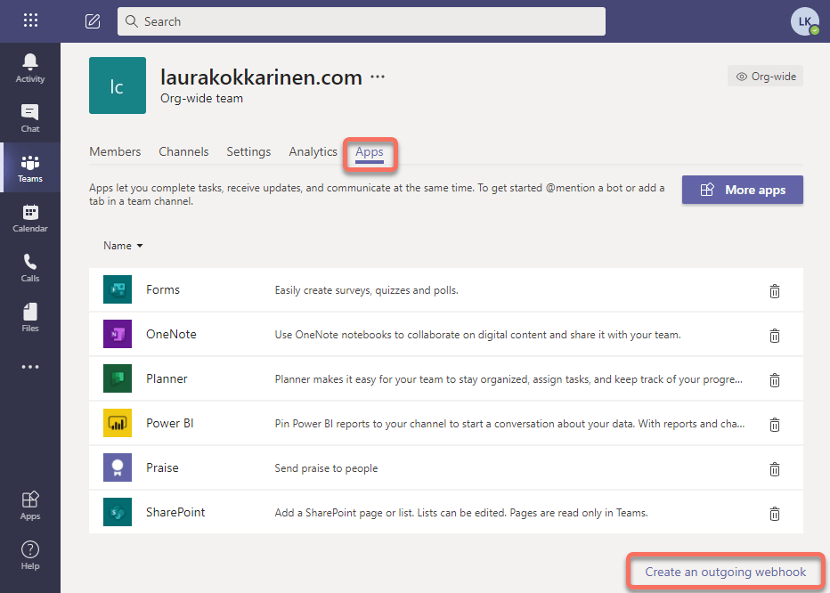
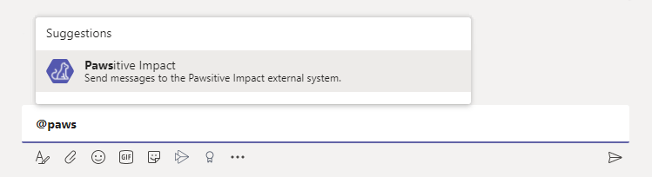
Outgoing webhooks
Send messages from Teams to an existing external system
Bot like user experience, super quick to create
The service can respond back to Teams
The external service needs to know how to process the message
Changes most likely need to be made to the service

Slide 14
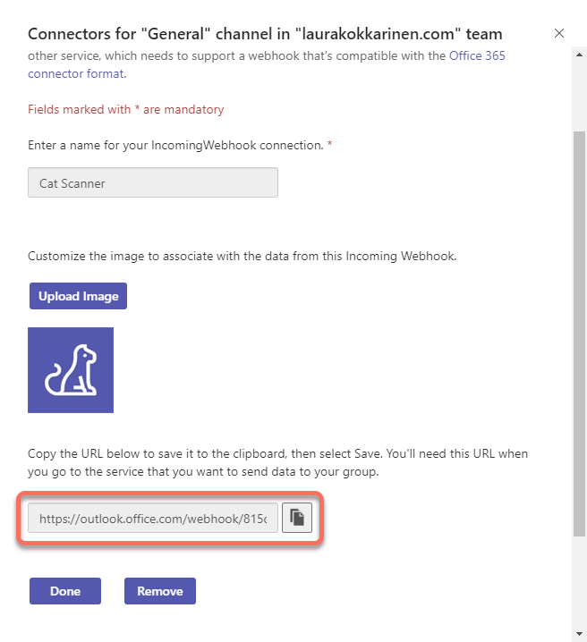
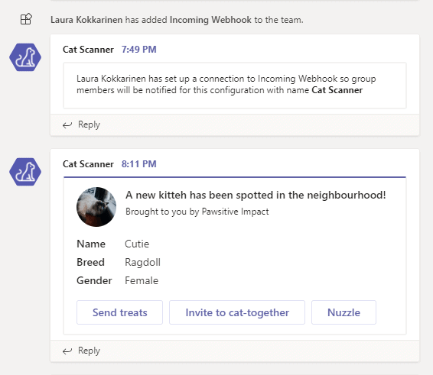
Incoming webhooks
Send messages from an external system to Teams
Adding a webhook gives you a URL where to send the messages (in JSON format)
Changes might need to be made to the service
Excellent for all kinds of channel-wide notifications!
Can’t be added to private or group chats (use bots instead)

Slide 15
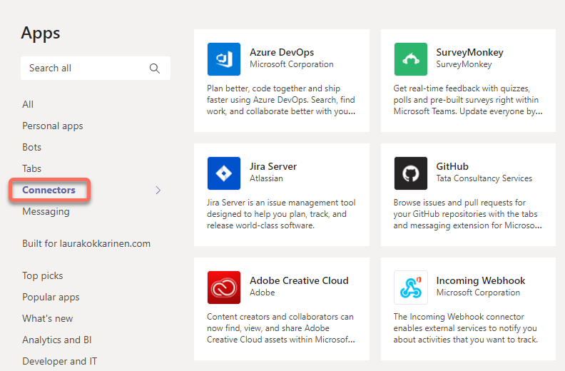
Connectors
Productized incoming webhooks

Slide 16
Other things
to include In your apps

Slide 17
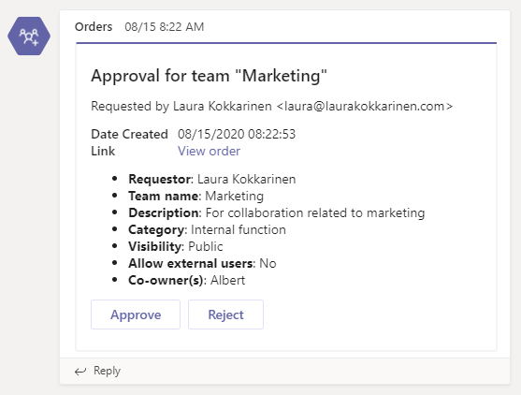
Adaptive cards
Formatted messages
Use on channels, private and group chats
Can be used from all kinds of apps
Need to be constructed following the JSON schema
https://docs.microsoft.com/en-us/microsoftteams/platform/task-modules-and-cards/cards/cards-reference
Insert the JSON into the HTTP request/response body

Slide 18
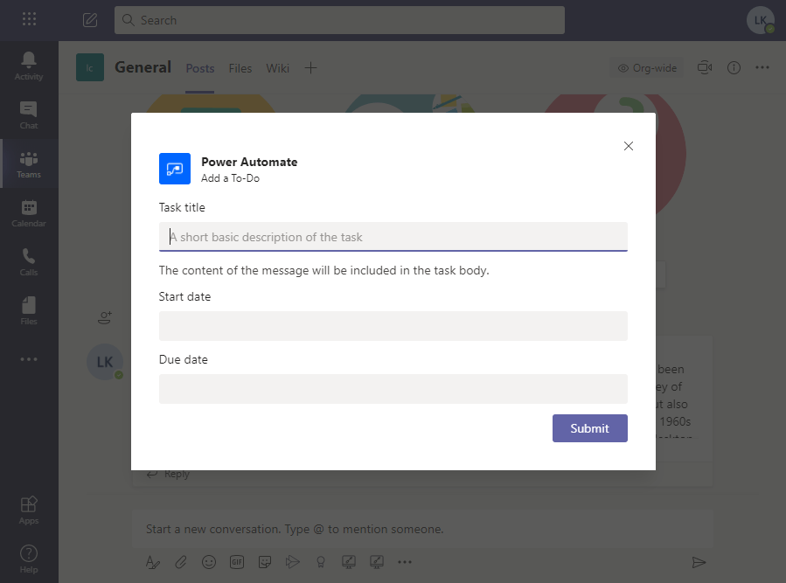
Task modules
Task modules
Modal windows for displaying/collecting info
Open via links, buttons, bot/messaging extension responses
Created by
Loading a web page in an iframe
Adaptive cards

Slide 19
When to create what type of app?
Do you want to display information?
Do you want to execute a background process?
Do you want to do both?
What is the most logical extension point for triggering your app?
What technologies you want to use?

Slide 20
Services and Tools
Used Azure PaaS services
Web app
Bot service
App service plan
Other Azure services based on requirements
Other options
SharePoint Framework (SPFx)
Power Apps
Power Automate
Power Virtual Agents
Tools for developing for Azure
C#
Visual Studio IDE with Microsoft Teams Toolkit for Visual Studio (https://marketplace.visualstudio.com/items?itemName=TeamsDevApp.vsteamstemplate)
Node.js (TypeScript)
Visual Studio Code with yo teams (https://docs.microsoft.com/en-us/microsoftteams/platform/tutorials/get-started-yeoman)
Ngrok (https://ngrok.com/) required for debugging bots and messaging extensions

Slide 21
Thank you!
Make sure to also check out these!
Teams tutorial videos by the PnP team: https://developer.microsoft.com/en-us/microsoft-teams/blogs/video-training-package-for-microsoft-teams-yeoman-generator/
Microsoft Teams app templates: https://docs.microsoft.com/en-us/microsoftteams/platform/samples/app-templates
Set up free Azure credits for M365 developer tenant: https://laurakokkarinen.com/how-to-use-the-complimentary-azure-credits-in-a-microsoft-365-developer-tenant-step-by-step/

